Slide 1
Level Set Method

Slide 2
Level set methods
Did you know that in 2008 a mathematician won an Academy Award?
Do you know how to model realistic hair for animation movies or a bomb deflagrating for an action movie?
Or you simply need some effective active contour segmentation method?
All these questions have in common an effective, yet intuitive, mathematical framework: level set methods.

Slide 3
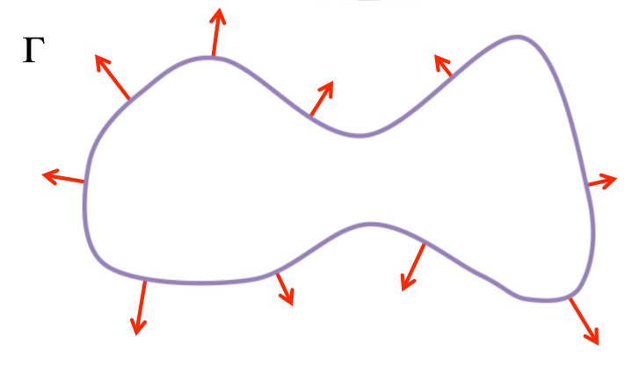
Interface
It is a "boundary" which clearly splits the space in two subsets ("inside" and "outside").
closed curve, changes in time.
The red arrows represent the velocity field, which gives information of how the curve will change.

Slide 4
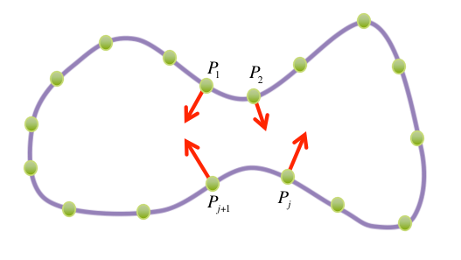
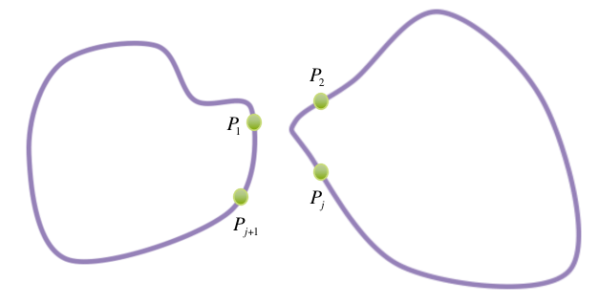
Interface Evolution
We are given an initial curve, Γ(t=0)Γ(t=0) and a velocity field v(t) which we assume is normal to the curve at any instant t.
We would like to determine and parameterise the evolution of the curve, that is Γ(t).
One intuitive idea is the following: let's choose some ordered points on our curve P₁,P₂,...,P_{s}P₁,P₂,...,P_{s}, let's follow their evolution (v will tell us where they are going) and let's complete the curve between any subsequent points P_{j} and P_{j+1} by interpolation.
However, it may happen that our curve will split under the action of v and Fig. B shows how our method would fail, because we told our algorithm to connect P₁ with P₂ and P_{j} with P_{j+1}.
How could we explain to our algorithms when the curve splits or merges? It's hard, especially since we are searching for a general method. This is where level set methods come to the rescue.

Slide 5
Interface evolving Equation
The idea is very intuitive: what if we would add one extra-dimension (time) and "record" the evolution with a surface? For instance, if our curve is a disc expanding, one candidate surface could be a truncated cone. If our disc would evolve in a "8-shape" and then split, one candidate surface would be some sort of 3-dimensional "Y". In other words, we are looking for a function such that
Here I denote the "inside" region at the time t by Ω(t). At any time, the zero level set of ϕ will detect the interface. In addition, its sign will detect the inside and outside regions
Now, observe that from the previous equation:
By applying the chain rule, we get
We assumed that our velocity field was orthogonal to the interface at any instant. In other words,
Hence, we can write the following evolution equation:
This, in addition to the given initial condition Γ(t=0), will define ϕ and consequently the interface at any time.

Slide 6
Wow
This new framework was introduced in 1987 by Stanley Osher and James Sethian. Since then, it has been a thriving topic of research: just know that their seminal paper to date has been cited more than 11 500 times!
Level set methods have been applied to an incredible variety of problems and settings: medical imaging, computer vision, image denoising, active contour segmentation, scattering, obstacle detection, and more.
Its richest areas of application is computer graphics.
One of Osher's students, Ron Fedkiw, now full professor at Stanford, won an Academy Scientific and Technical Award in 2008.
Fedkiw is a consultant for Industrial Light and Magic, a big name in the special effects industry.
He worked on blockbusters as Terminator III, Star Wars Episode III, the Pirates of the Caribbean's saga and some Harry Potter movies. Level set methods are widely used in fluid, fire, hair simulations in animation movies. Think of water, with all his splashes (=topological changes): this framework works very well

